Slide 1
LESGO code and Github
Ghanesh Narasimhan

Slide 2
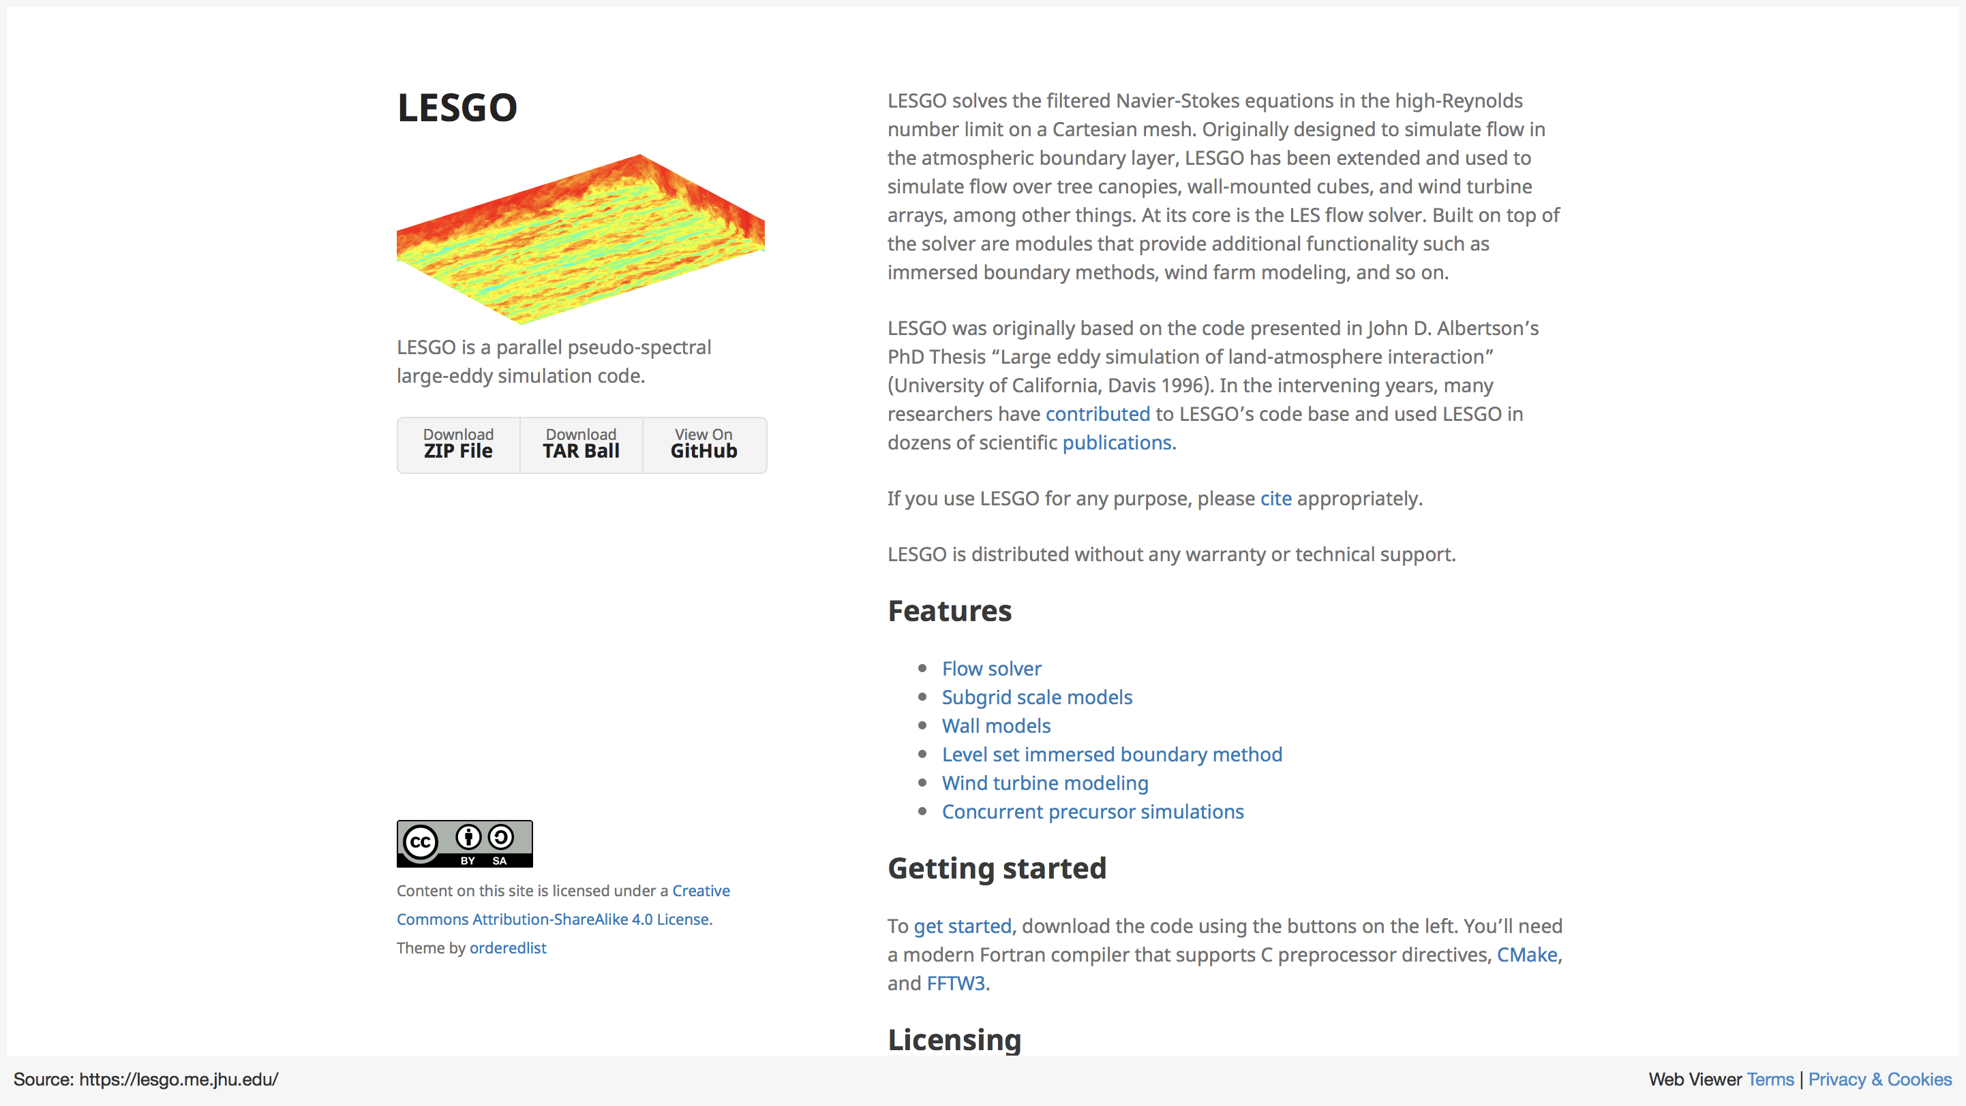
Notes:
https://lesgo.me.jhu.edu/

Slide 3


Slide 4
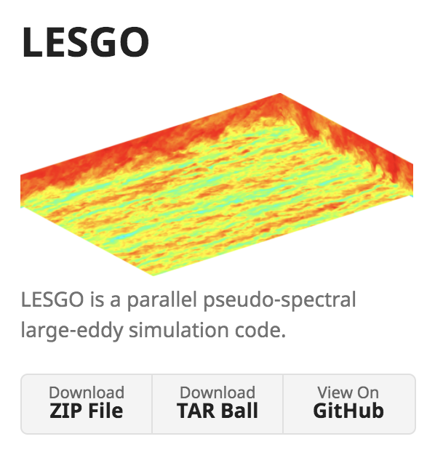
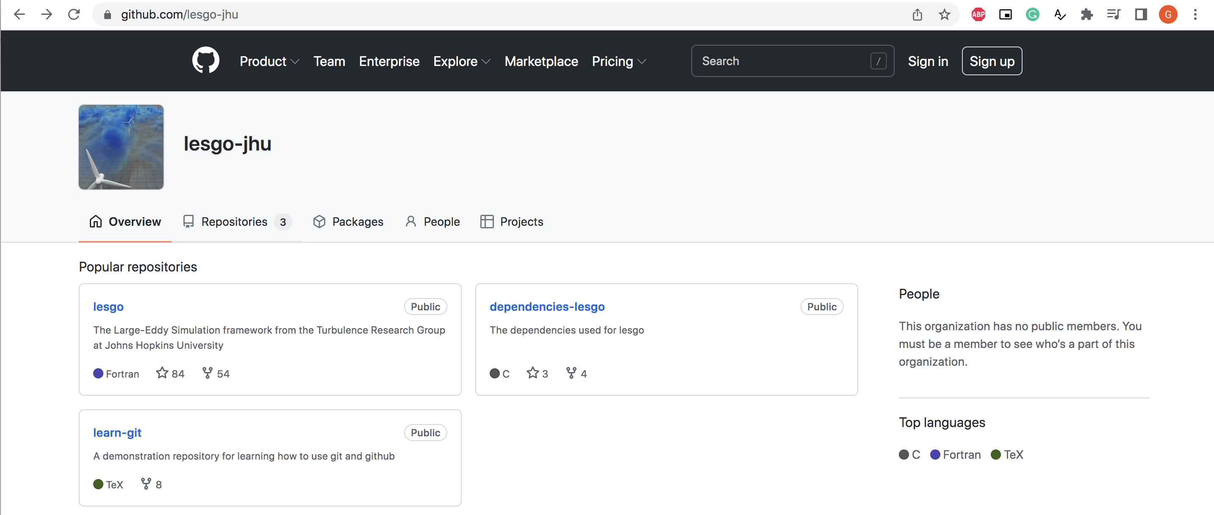

Slide 5
https://github.com/lesgo-jhu
https://github.com/ghanesh91
ghanesh91
repo1
repo2
repo3
repo4
learn-git
ghanesh91
repo1
repo2
repo3
repo4
learn-git
lesgo-jhu
lesgo
learn-git
dependencies-lesgo
Fork

Slide 6
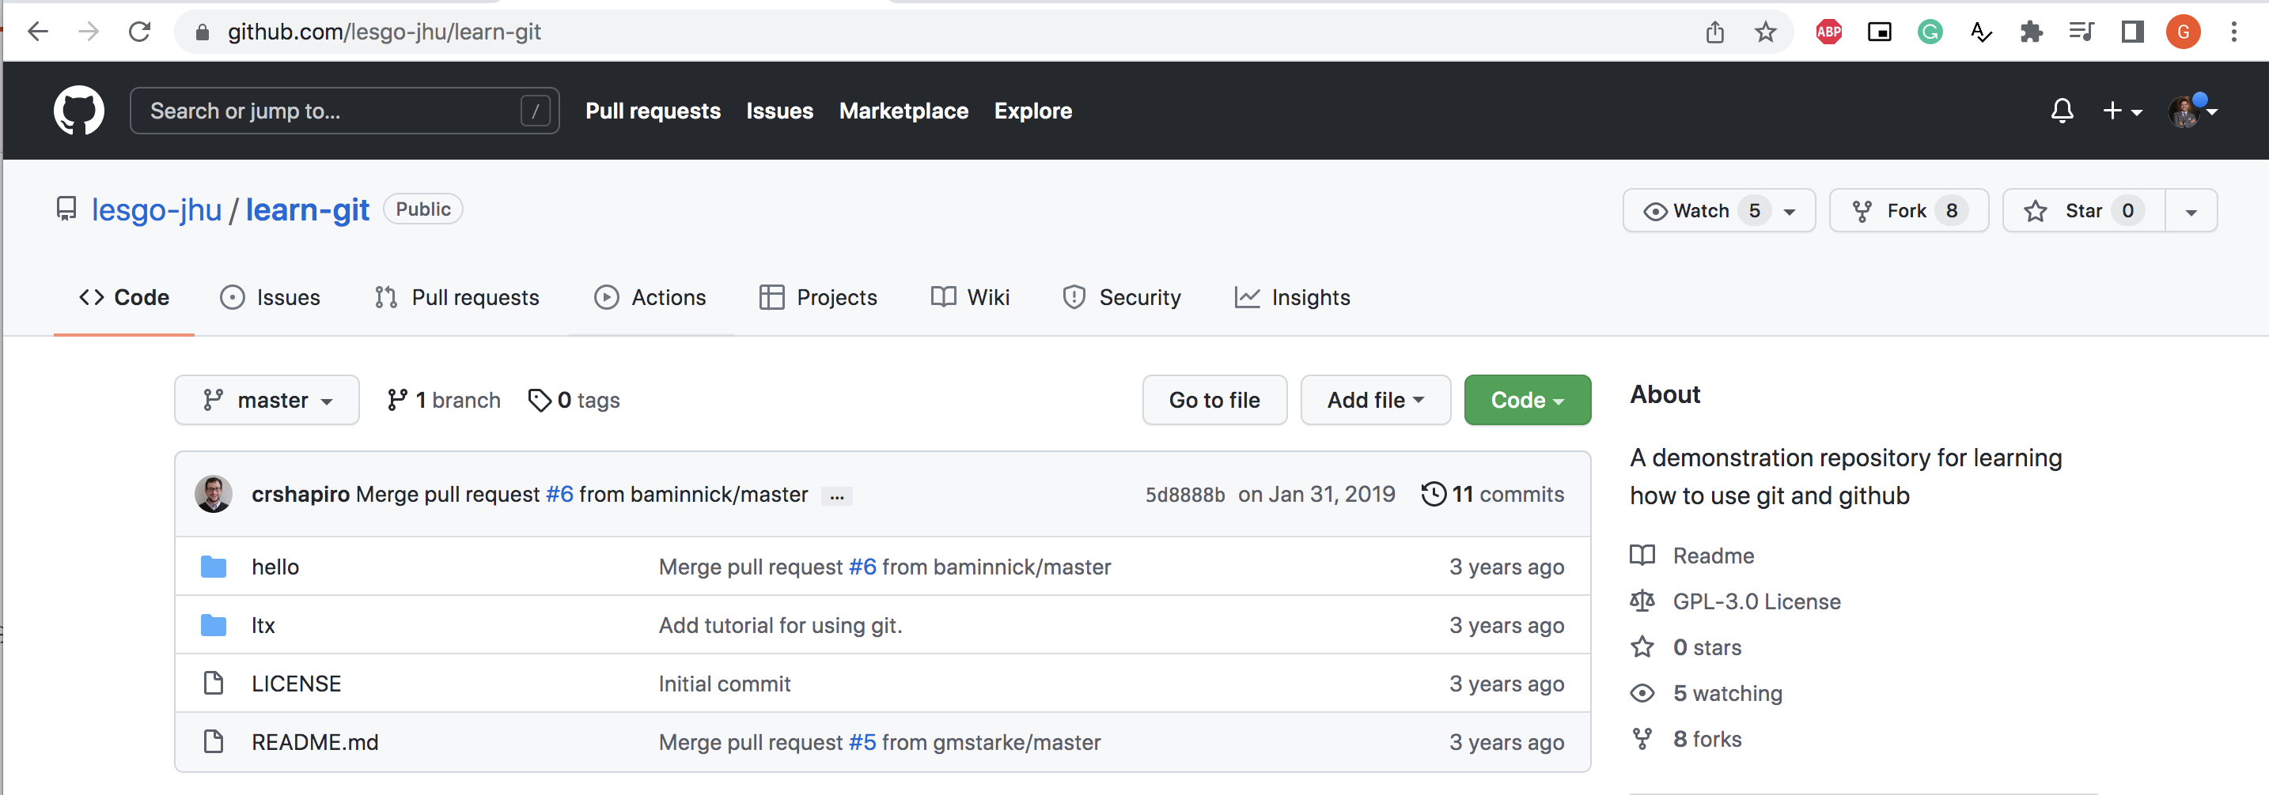
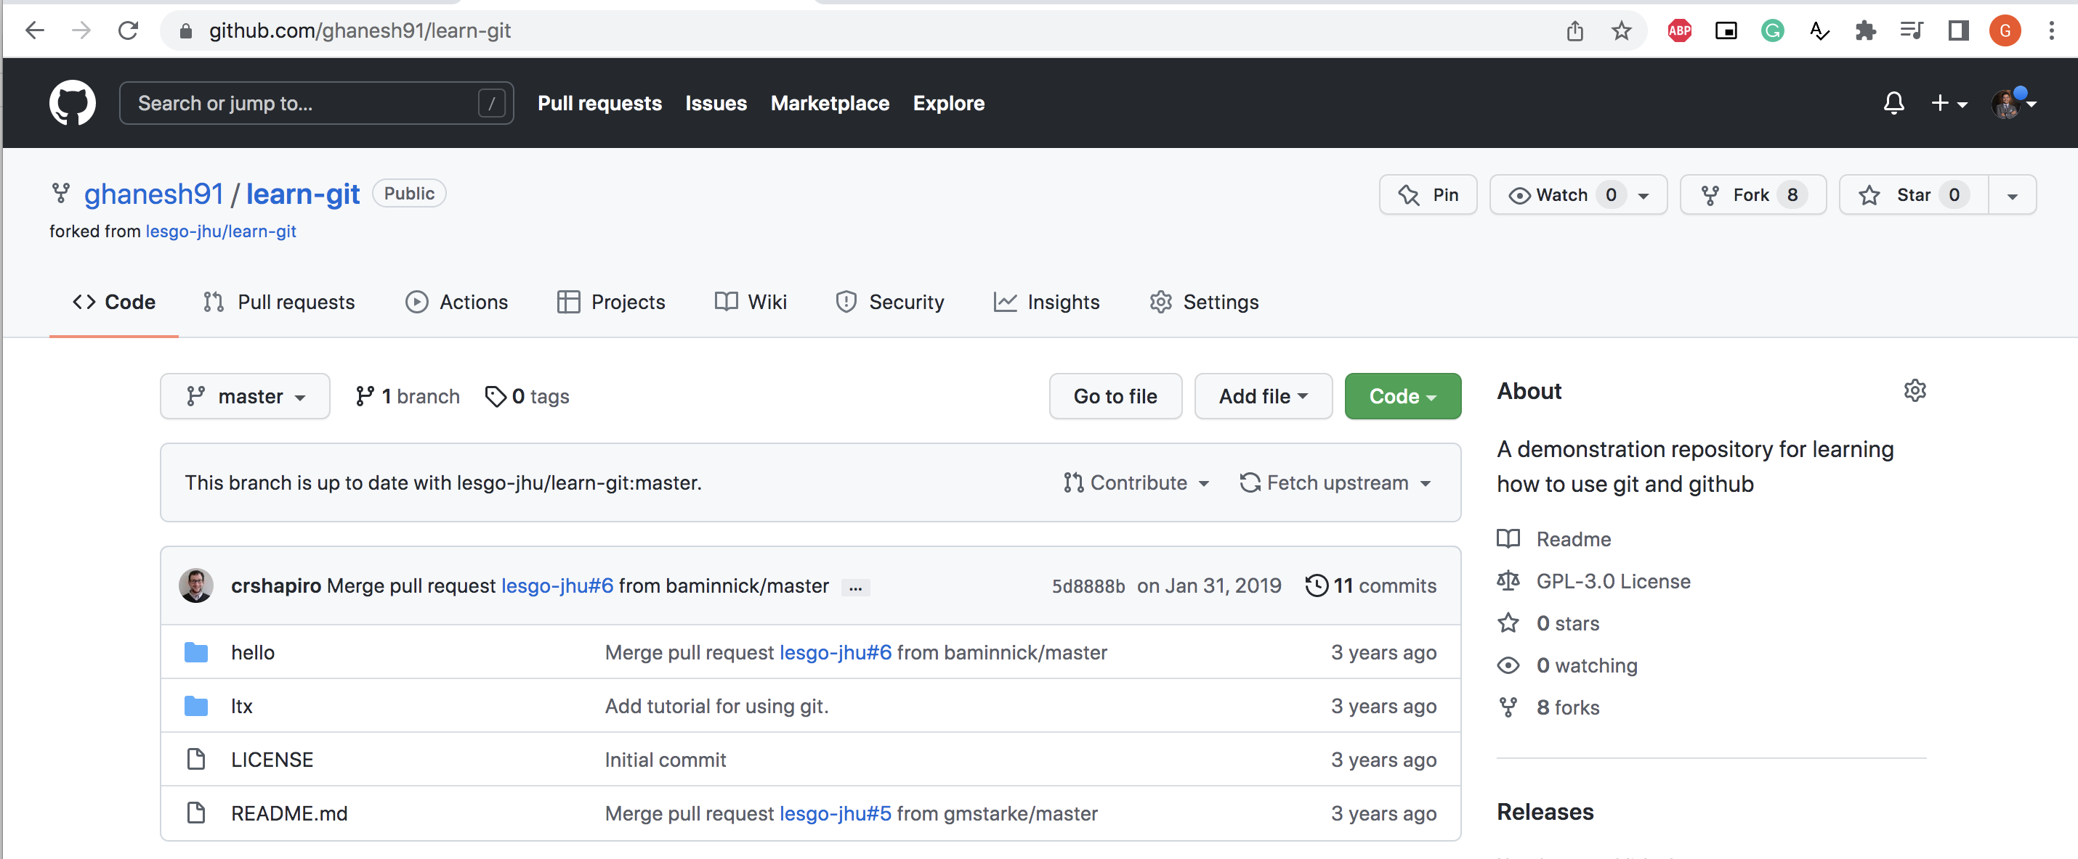
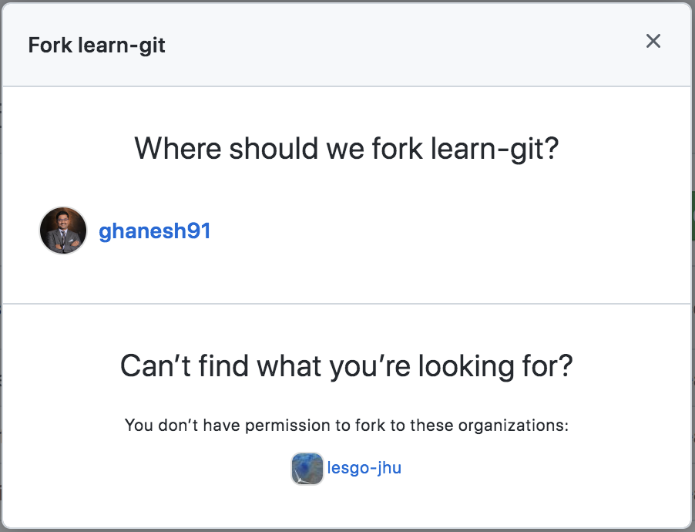
Forking

Slide 7

git clone – copy file to local machine
https://github.com/lesgo-jhu
https://github.com/ghanesh91
ghanesh91
repo1
repo2
repo3
repo4
learn-git
lesgo-jhu
lesgo
learn-git
dependencies-lesgo
Fork
git clone

Slide 8
local machine - ORIGIN and UPSTREAM
https://github.com/lesgo-jhu/learn-git
(UPSTREAM)
https://github.com/ghanesh91/learn-git
(ORIGIN)
lesgo-jhu
lesgo
learn-git
dependencies-lesgo
ghanesh91
repo1
repo2
repo3
learn-git
Fork
git clone

Slide 9
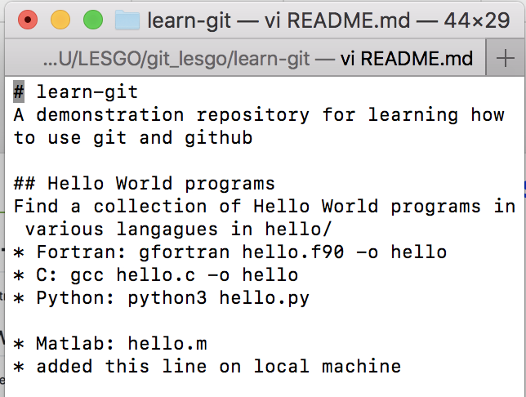
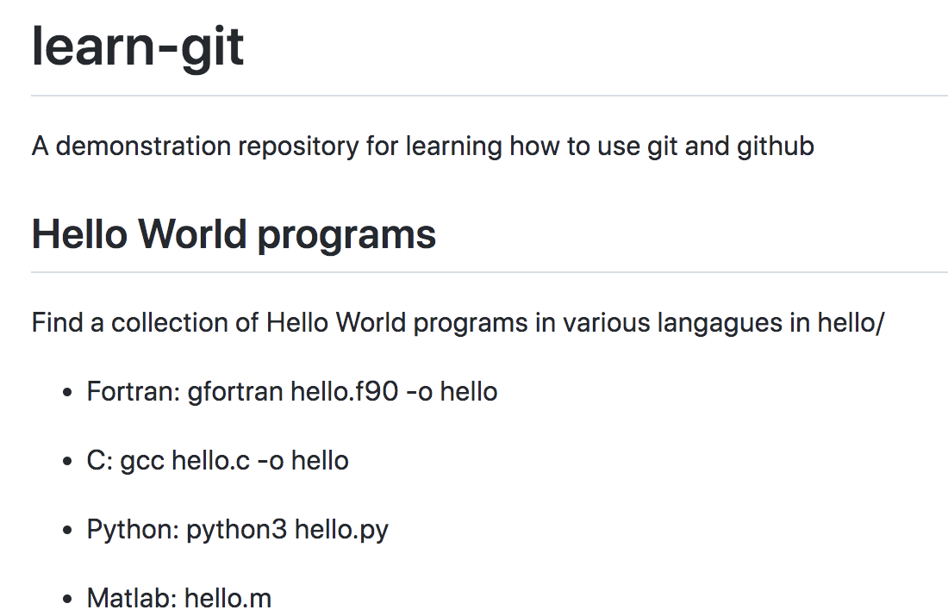
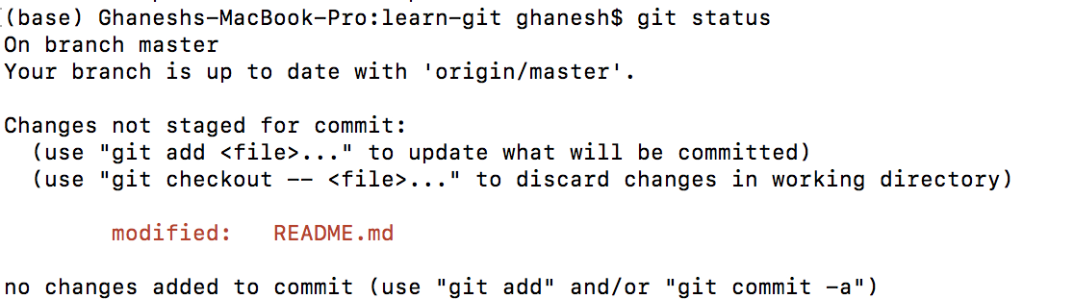
Updating changes to a code – git status
https://github.com/ghanesh91/learn-git

Slide 10
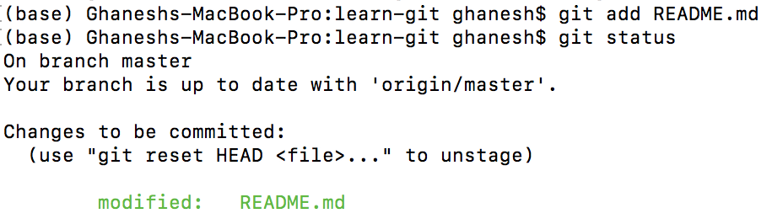
Updating changes to a code – git add
https://github.com/ghanesh91/learn-git

Slide 11
Updating changes to a code – git commit
https://github.com/ghanesh91/learn-git

Slide 12
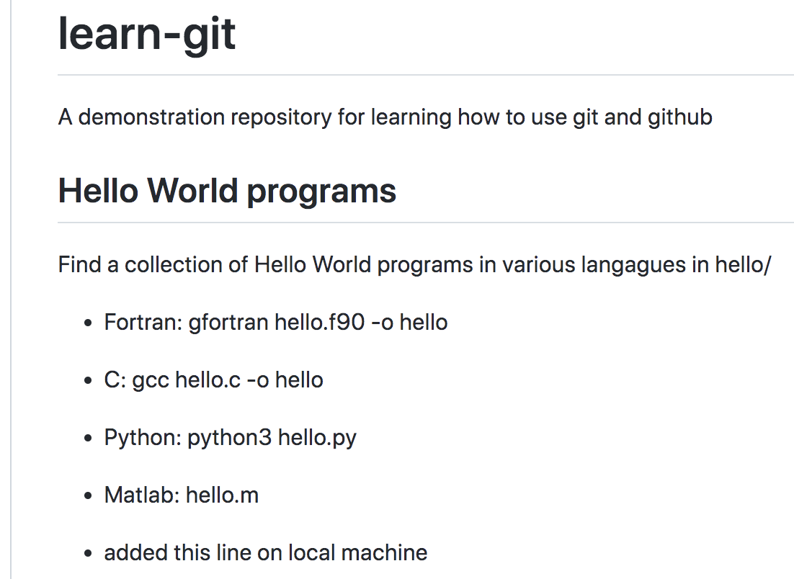
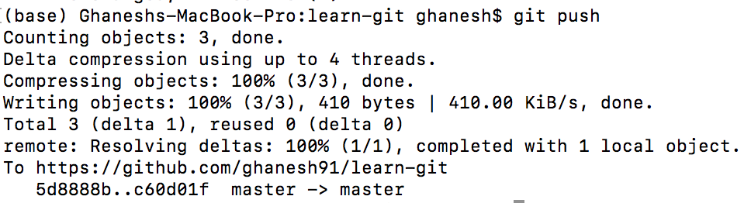
Updating changes to a code – git push
https://github.com/ghanesh91/learn-git

Slide 13
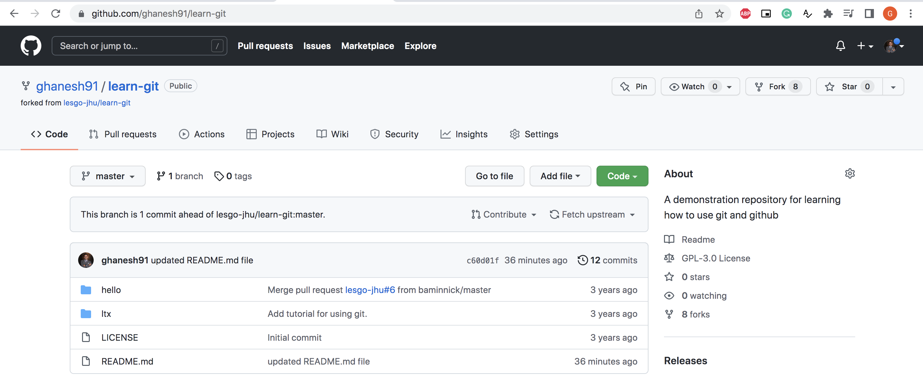
Updating changes to a code

Slide 14
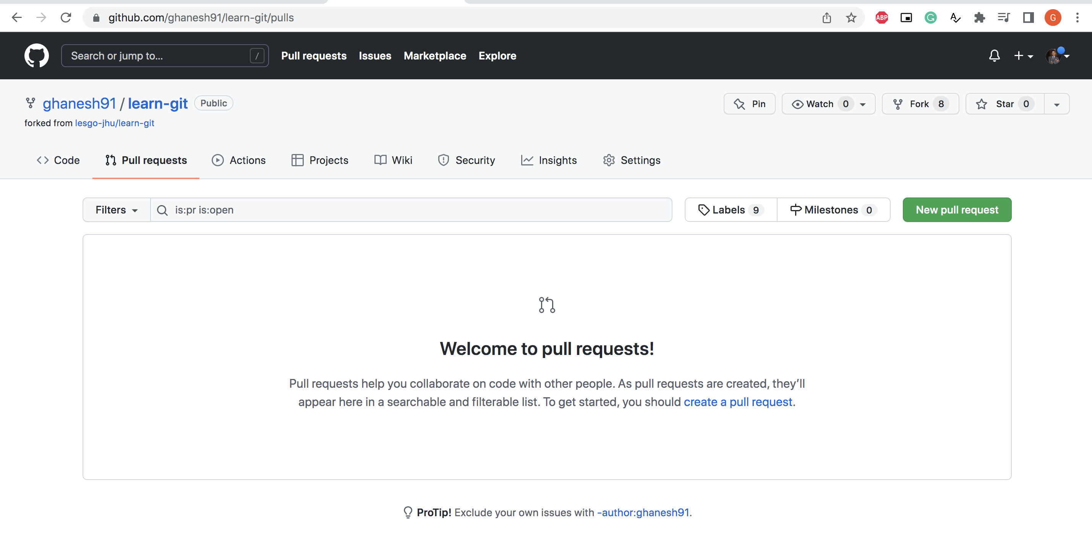
Pull request – make changes in main repo

Slide 15
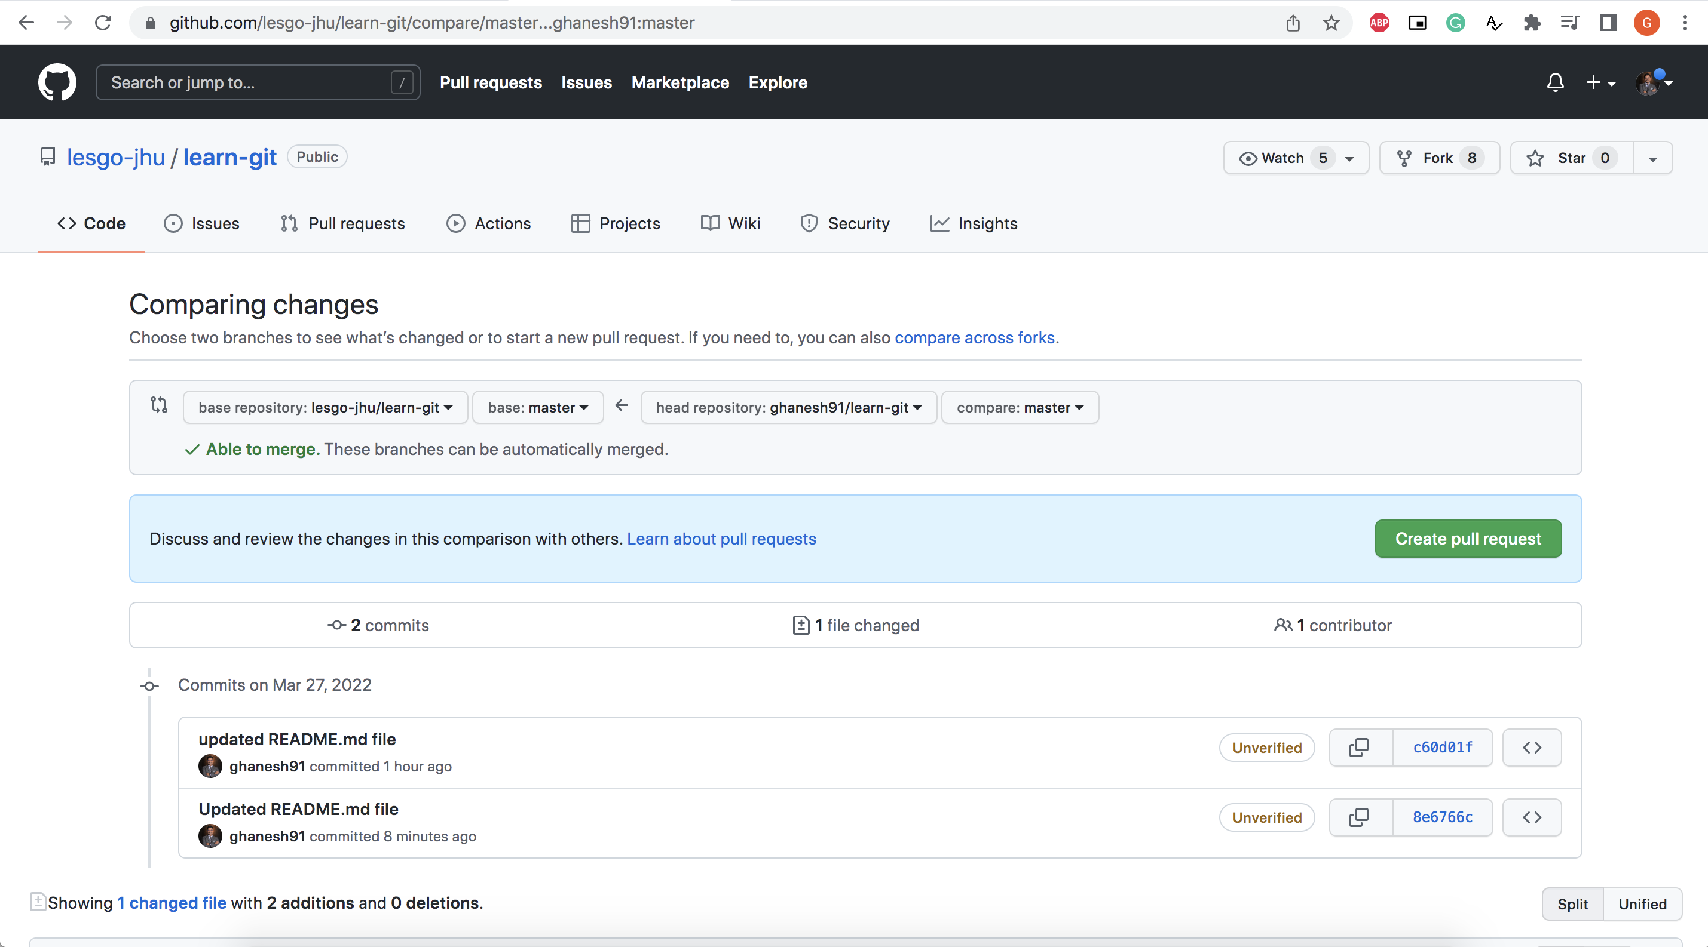
Pull request – make changes in main repo

Slide 16
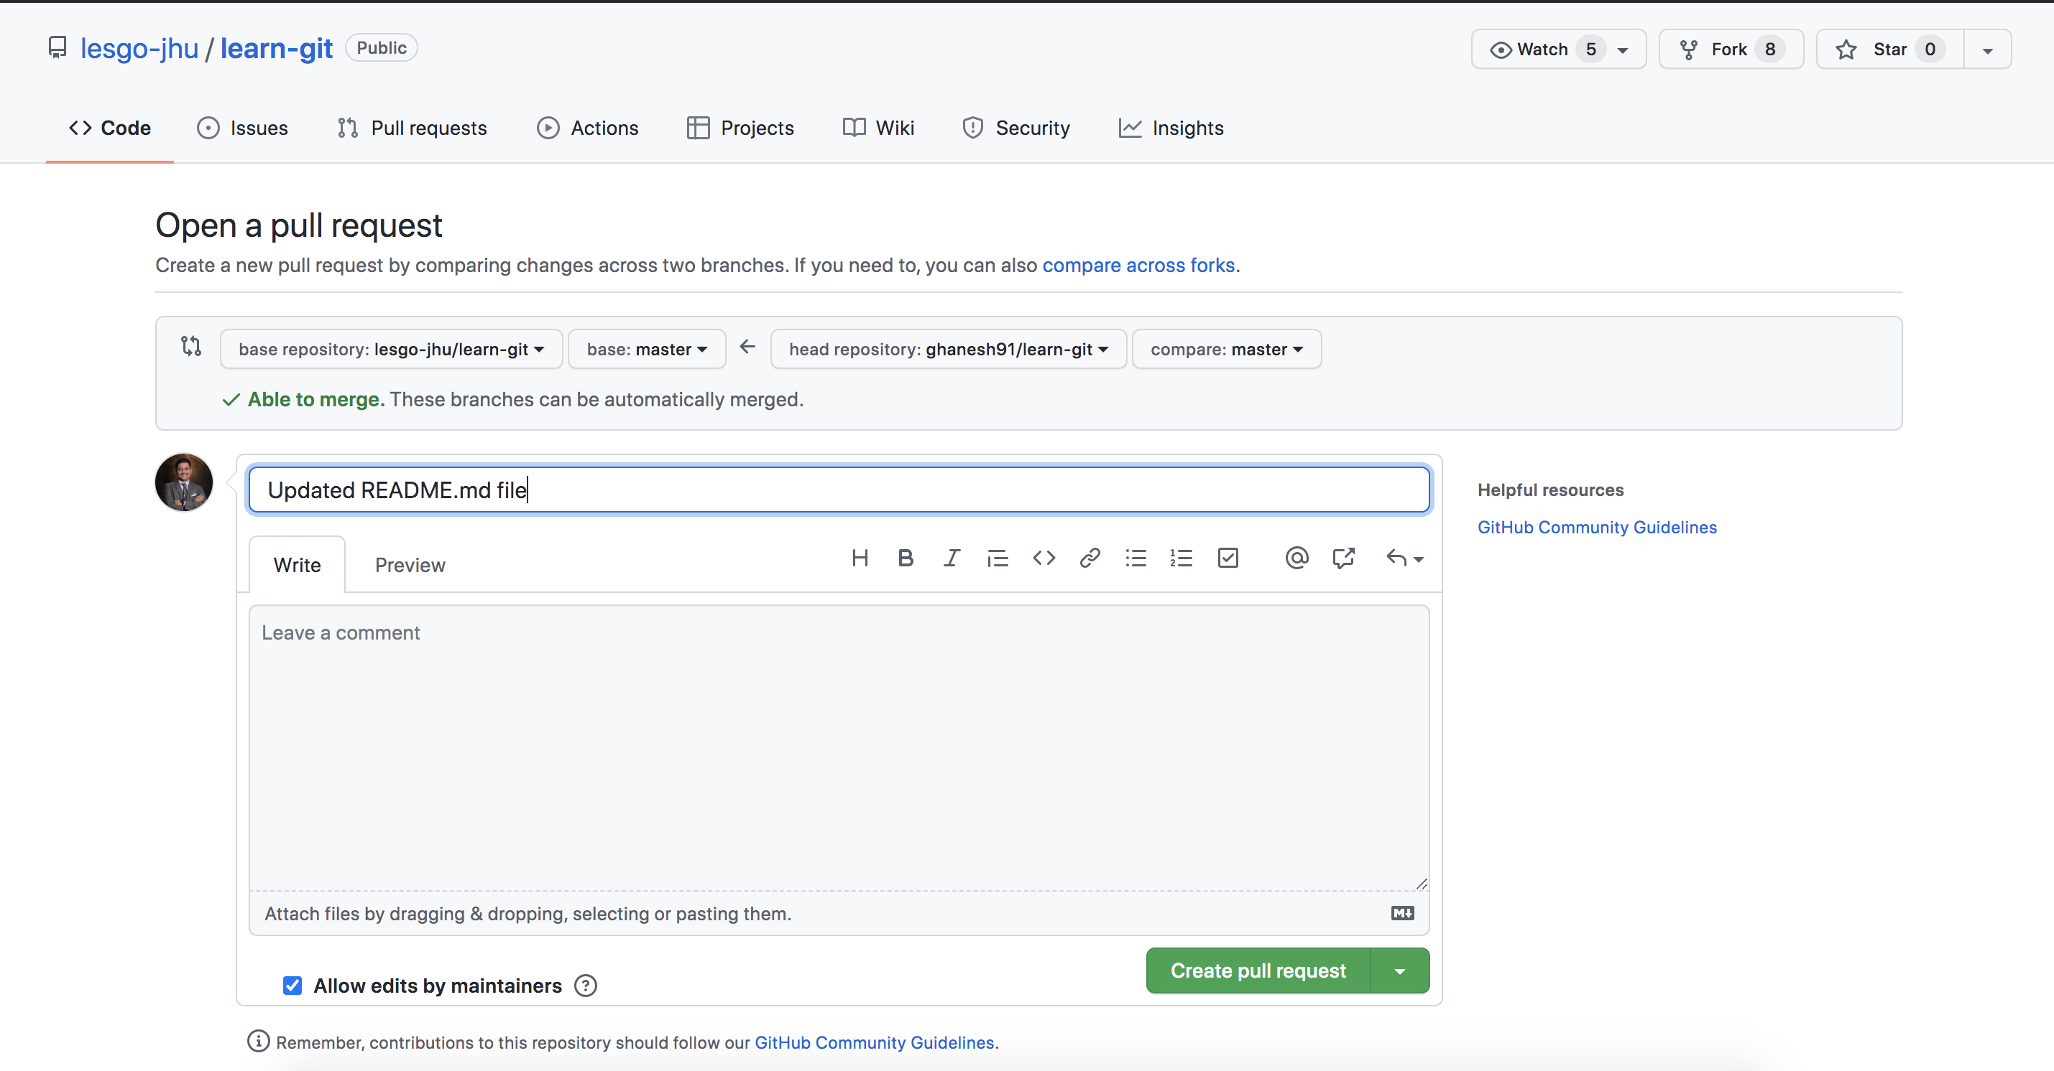
Pull request – make changes in main repo

Slide 17
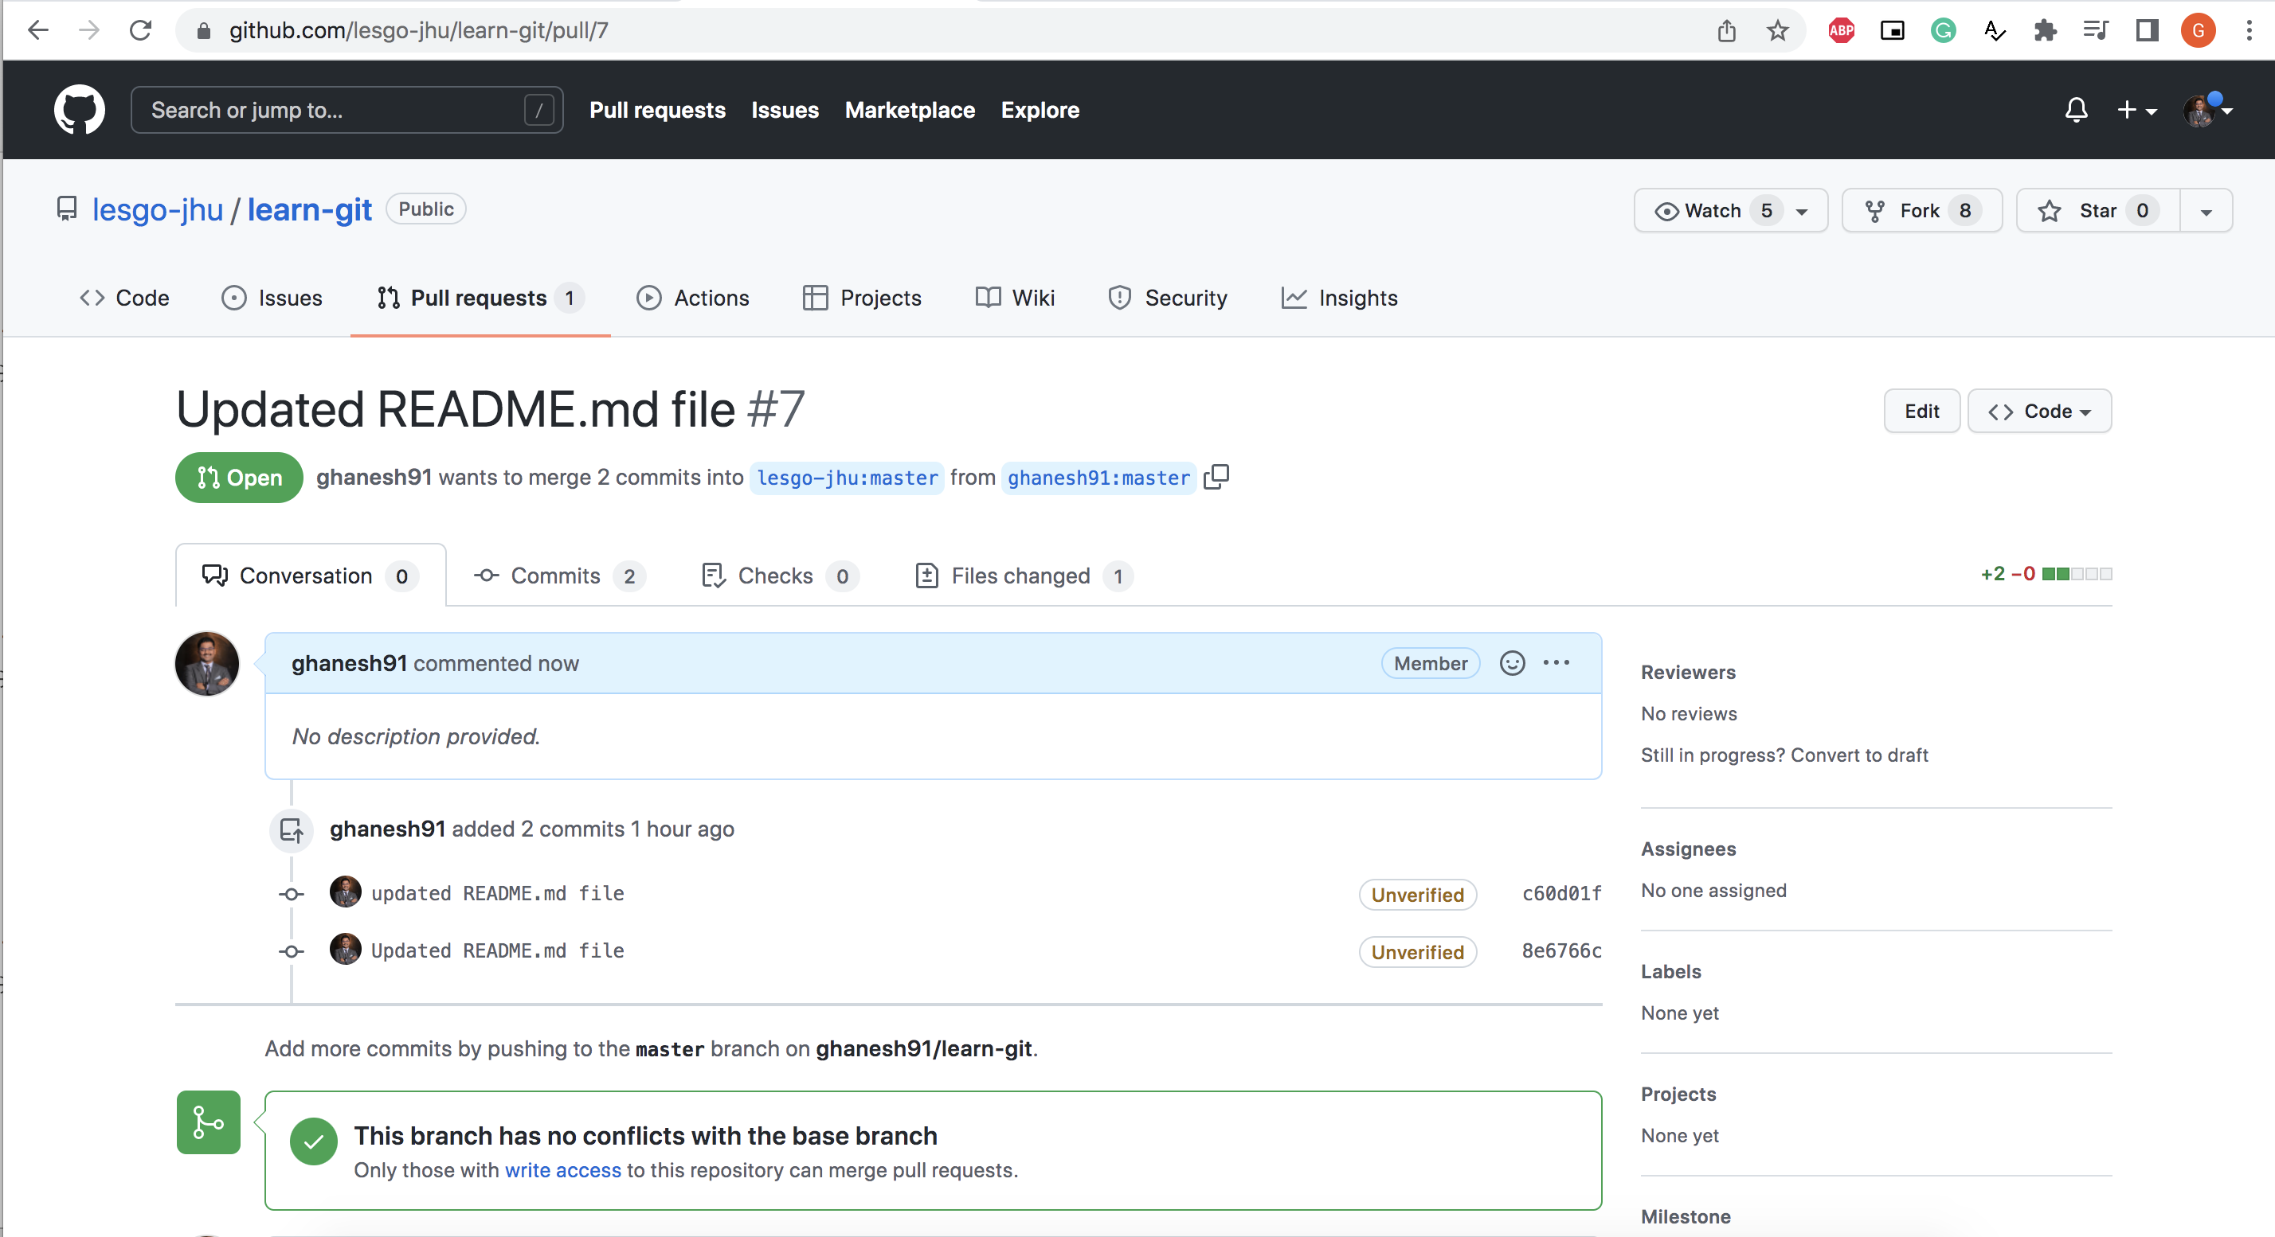
Pull request – make changes in main repo

Slide 18
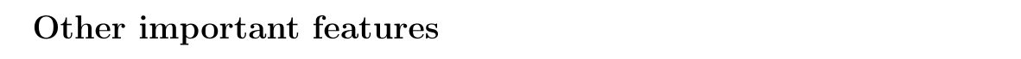
Final steps
Once the changes are approved by the admin, update origin to be in the same level as the upstream.
https://www.atlassian.com/git/tutorials/using-branches
git branch -
https://www.atlassian.com/git/tutorials/using-branches/git-merge
git merge -
https://www.atlassian.com/git/tutorials/rewriting-history/git-rebase
git rebase -
https://www.youtube.com/watch?v=dO9BtPDIHJ8
rebase vs merge -

